Slide 2
The Creaking Grounds

Slide 3
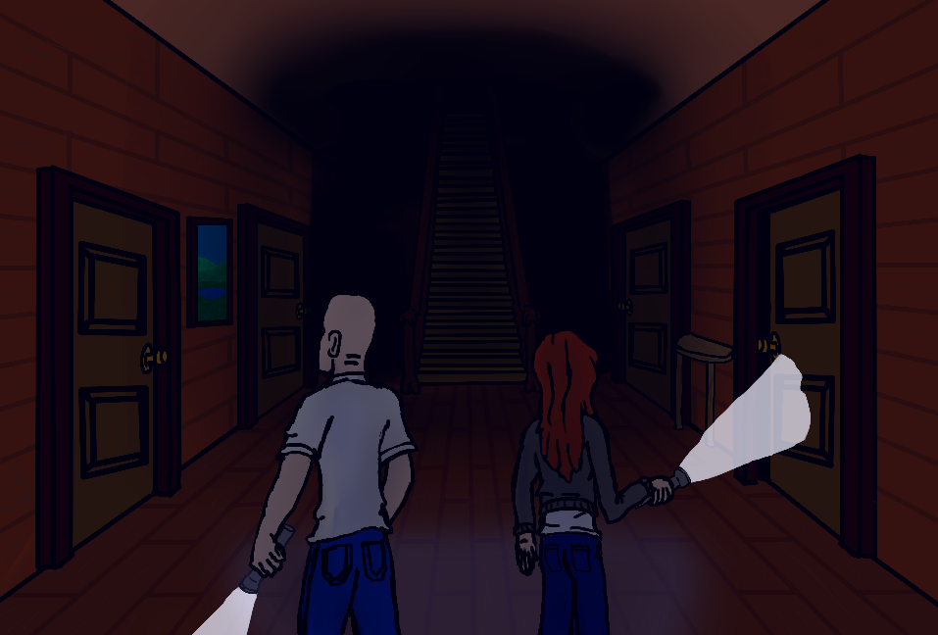
Razor Statement
Explore the old mansion collecting items to survive. But beware the cursed spirits of this house who lie in wait with surprises of their own.

Slide 4
User Stories
As the player I will
Customize my character and select abilities that suit my play style.
Explore the mansion in order to find more equipment
Search rooms in order to find items to help me survive
Complete various objectives in order to defeat the betrayer and win the game.
As a Betrayer I will attack the players in different ways in order to win the game.

Slide 5
Game Features
Explore a randomly generated labyrinthian mansion
Create a character with stats to suit your play style
Search the rooms and containers for items and artifacts
Find hidden passages and secrets to help you win
Collect special powers from artifacts
Survive the Curse’s Awakening OR Destroy the trespassers as a Betrayer.

Slide 6
Why Are We Different?
Most horror games are linear and repetitive. Ours is not.
Multiplayer
We are an ambitious group that focuses on quality
Much accomplished in short time already = PROFIT SOONER FOR YOU

Slide 7

Demo

Slide 8
The Creaking Grounds

